Slide 1

Supervised ML – Regression Capstone Project On Credit Card Prediction
PREPARED BY
SAAQUIB MUSTAFA
SAHIL KOLAMBKAR
RAJA CHOWDHURY
SANDIPAN DAS

Slide 2
INDEX
INTRODUCTION
PROBLEM STATEMENT
DATA SUMMARY
APPROACH OVERVIEW
BASIC EXPLORATION
EDA
MODELING OVERVIEW
FEATURE IMPORTANCES
CHALLENGES
CONCLUSION

Slide 3

Introduction
Credit card default prediction is the process of using historical data to predict whether or not a credit card holder will default on their payments in the future. Default prediction is important for both lenders and borrowers, as it can help lenders to identify high-risk customers and make better lending decisions, while helping borrowers to understand their chances of default and take steps to avoid it.

Slide 4
Problem Statement
This project is aimed at predicting the case of customers default payments in Taiwan. From the perspective of risk management, the result of predictive accuracy of the estimated probability of default will be more valuable than the binary result of classification - credible or not credible clients. We can use the K-S chart to evaluate which customers will default on their credit card payments.

Slide 5
Data Summary
X1 - Amount of credit limit(includes individual as well as family credit)
X2 - Gender
X3 - Education
X4 - Marital Status
X5 - Age
X6 to X11 - History of past payments from April to September
X12 to X17 - Amount of bill statement from April to September
X18 to X23 - Amount of previous payment from April to September
Y - Default payment

Slide 6
Approach Overview
Data Cleaning and Understanding
Find information on documented columns values
Clean data to get it ready for Analysis
Data Exploration (EDA)
Examining the data with visualization
Plotting graphs
Modeling (Machine Learning) METRICS
Logistic Regression 1. Confusion Matrix
Support Vector Classifier 2. Accuracy Score
Decision Tree Classifier 3. Precision Score
Random Forest Classifier 4. Recall Score
XGBoost 5. F1 Score 6. Roc_Auc Score

Slide 7
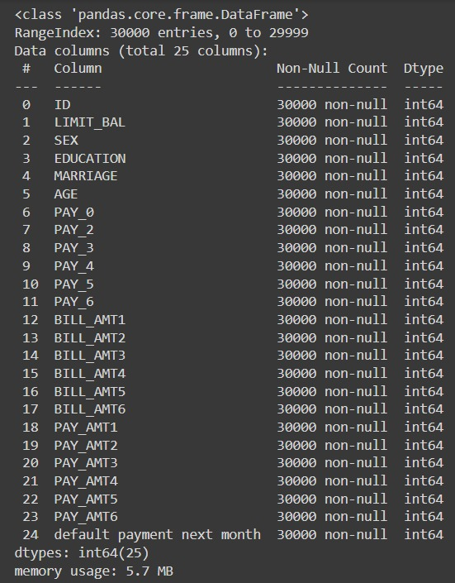
Basic Exploration
Dataset for Taiwan.
Shape of data is 30000 rows and 25 columns
Six months payment and bill data available.
No null values present in dataset.
Nine Categorical variables present.
ID column can be dropped as it won’t impact
our dataset.

Slide 8
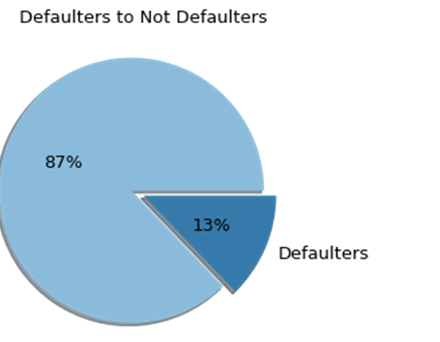
Ratio of Defaulter to Non-Defaulter
In our dataset the ratio of defaulter to non defaulter is 87:13. That is 13% are defaulters while the rest pays on time.

Slide 9

Gender Distribution
In our dataset,
There are 8001 Males and 12,927 Females.

Slide 10
Defaulter Ratio With Respect To Gender
Females are ahead of males in case of both default and non default.

Slide 11
Defaulter Ratio With Respect To Marital Status
The above calculation says that
Single people are more likely
to fail to pay on time while followed by married
People and others are less in both the cases.

Slide 12
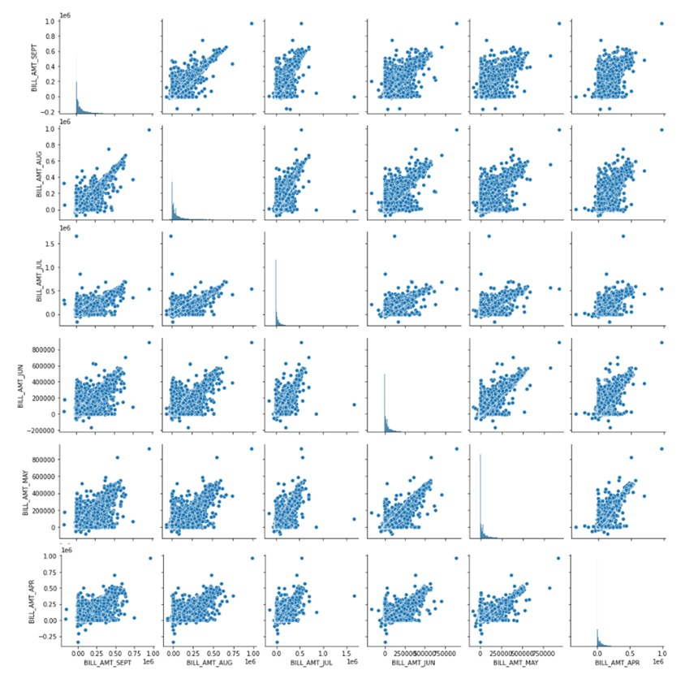
History Of
Bill Amount Payment
Bill amount for each month is highly correlated with each other hence we will try to feature engineer bill amount to Dues column to reduce multicollinearity.

Slide 13
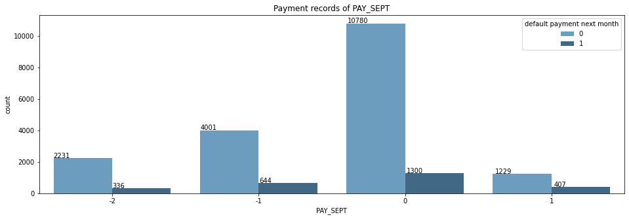
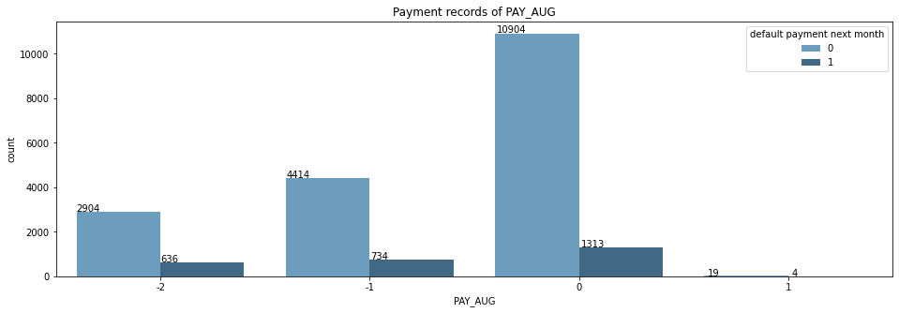
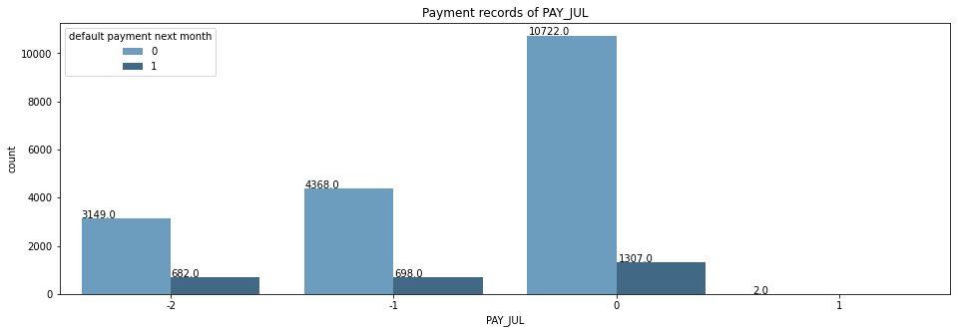
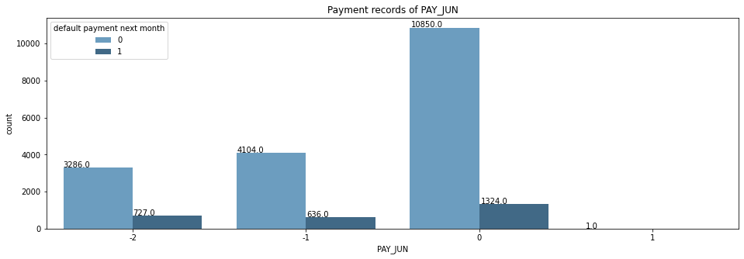
History Of Past Payment
From history of past payment it is clear that most people who pay duly are not likely to default their payment

Slide 14
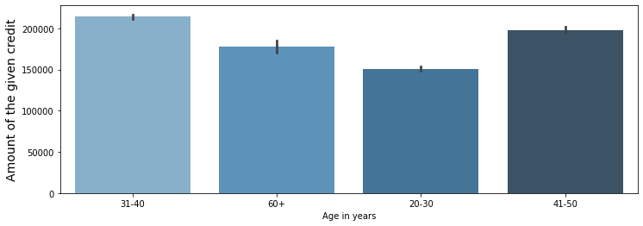
Allotment Of Credit Limit Balance
From the graph it can be clearly visible that highest amount of credit was given to the age bracket of 31-40 and 20-30 age group consists of least amount of credit.

Slide 15
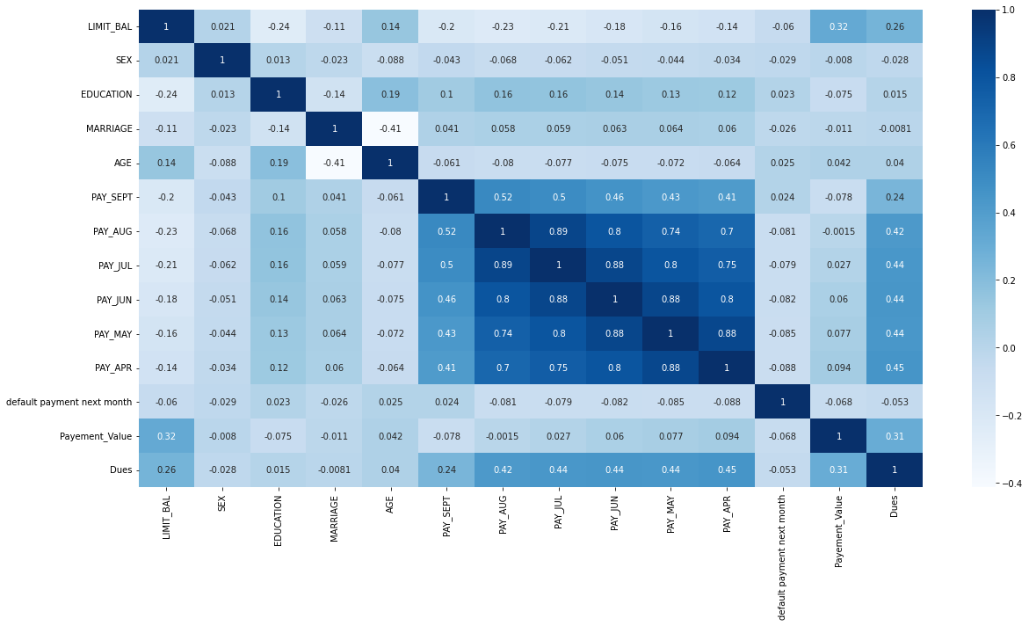
Treatment of multicollinearity
We have removed some of the highly correlated variables which were influencing our dataset

Slide 16
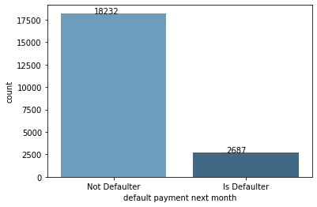
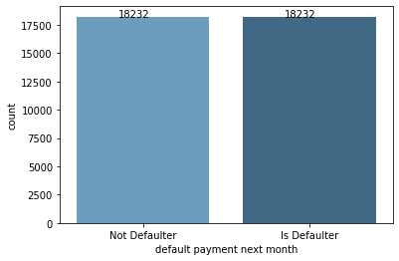
Modeling Overview
Supervised learning/Binary Classification
Imbalance data We can clearly see there is an imbalance in this data.So we used SMOTE technique to deal with this
S

Slide 17
Machine Learning Algorithms and Metrics used
Modeling (Machine Learning) METRICS
Logistic Regression 1. Confusion Matrix
Support Vector Classifier 2. Accuracy Score
Decision Tree Classifier 3. Precision Score
Random Forest Classifier 4. Recall Score
XGBoost 5. F1 Score 6. Roc_Auc Score

Slide 18
Modeling Steps
Data Preprocessing
Feature selection and Feature engineering
Train test data split(80%-20%)
SMOTE oversampling(Synthetic Minority Oversampling Technique)
Data Fitting and Tuning
Start with default model parameters
Hyperparameter tuning
Measure AUC- ROC on training data
Model Evaluation
Model testing
Precision Recall Score
Compare with the other models

Slide 19
Conclusion
Random forest is the best algorithm for our model. Recall is 84%(meaning out of 100 defaulters 84 will be correctly caught by Random forest)
Logistic Regression has the least recall score of 72%
SR.NO | CLASSFIER | ACCURACY | PRECISION | RECALL | F1 SCORE | ROC_AUC
01 | LOGISTIC REGRESSION | 73% | 72.5% | 72.2% | 72% | 73%
02 | SVC | 75% | 71% | 76% | 73% | 75%
03 | DECISION TREE | 78% | 81% | 75% | 78% | 78%
04 | RANDOM FOREST | 84% | 84% | 84% | 84% | 84%
05 | XGBOOST | 81% | 80% | 81% | 81% | 81%

Slide 20
SL.no. | Classifier | Accuracy | Precision | Recall | F1 Score | ROC_AUC
1 | Logistic Regression | 73% | 72% | 72% | 72% | 73%
2 | SVC | 75% | 71% | 76% | 73% | 75%
3 | Decision Tree | 77% | 76% | 77% | 77% | 77%
4 | Random Forest | 84% | 84% | 83% | 84% | 84%
5 | XG Boost | 83% | 83% | 83% | 83% | 83%

Slide 21
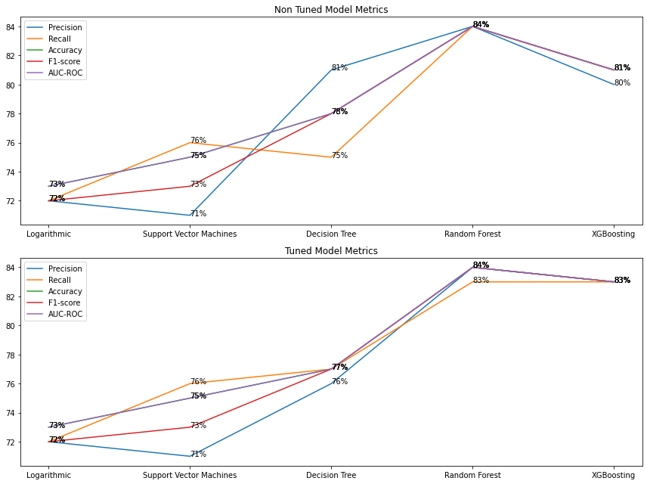
Graphical Representation of tuned and untuned metrics

Slide 22
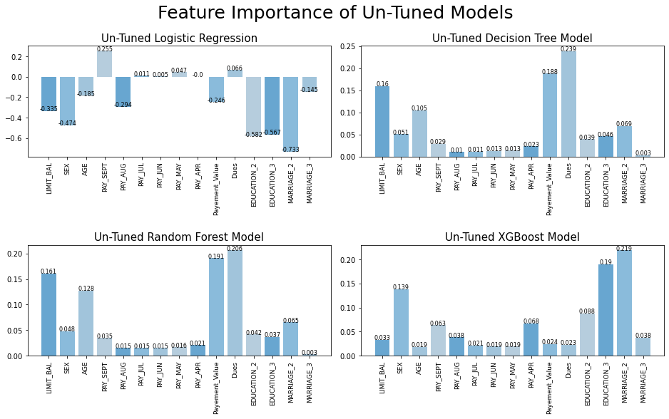
Feature importance of un-tuned models

Slide 23
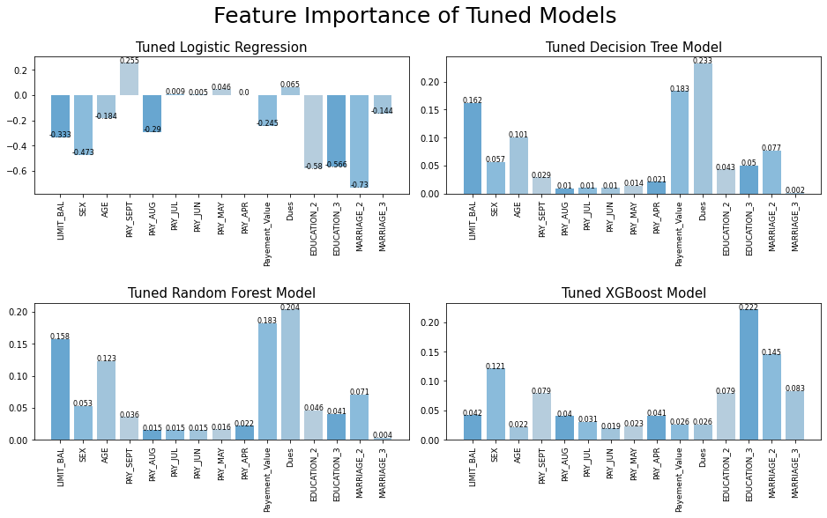
Feature importance of tuned decision models

Slide 24
Challenges
Dealing with all the Categorical variables present in the dataset.
Understanding the dataset.
Cleaning dataset and dealing with outliers
Dealing with multicollinearity.
Selecting the right model and right evaluation metrics.

Slide 25
Conclusions
The number of people who will default their payment is much less than number of people of people who will pay on time.
The Number of females are much more than males in our dataset (6,224) and we can also say that females tend to pay their default on time compared to their male counterparts.
Married people are more likely to pay their default payments compared to singles and others
We can also say that Singles do not pay their default payment marginally as compared to married counterparts.
Bill amount for each month is highly correlated with each other hence we will try to feature engineer bill amount to Dues column to reduce multicollinearity.
we can see that pay amount tends to clutter at one place hence we can try to feature engineer pay amount columns to one payment column to declutter our data.

Slide 26
From history of past payment analysis it is clear that most people who pay duly are not likely to default their payment
Here, we can say from age 21 to 39 limit balance is increasing however from 39 to 61 it started to decline and then from 62 to 79 it has increased drastically
In our dataset, We used many algorithm like Logistic Regression, Support vector classsifier,decision tree classifier,XGBoost Classifier,Random Forest Classifier but among all these modelsRandom Forest was the best performing algorithm

Slide 27


Slide 28
Thank You

